Slide 1

Marvel vs DC Franchise
Project 1
Nate Savage, Frenci De la Cruz, Drew Bollinger, Nikki Alfrey
Image Credit: https://www.clarendonhousebooks.com/single-post/why-dc-can-never-hope-to-emulate-marvel-in-the-cinema

Slide 2


Project 1: Marvel vs DC Universe
Most people have a favorite superhero and version of that superhero, which leads one to ask, which is better, Marvel or DC? How do you determine which is better?
We used a dataset to review budgets, profits, character leads, length of films, and Rotten Tomato scores to help us determine a franchise that is super-ior.

Slide 3

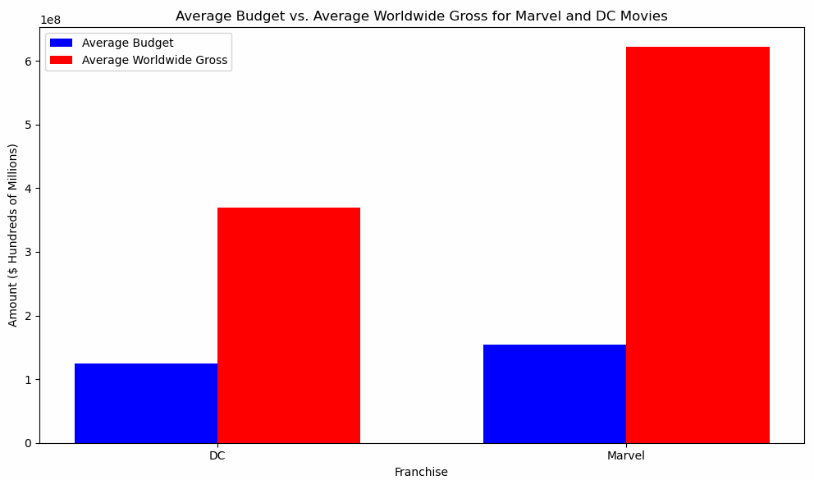

What relationship does budget have to box-office worldwide profits?
DC’s average budget is $124.6M and box office gross is $369.2M
Marvel’s average budget is $154.6M and box office gross is $621.6M

Slide 4

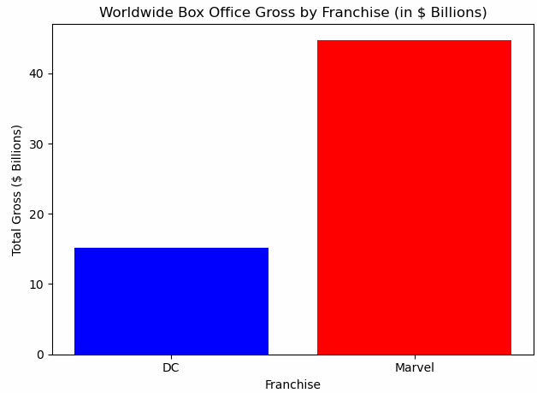

How do the two franchises compare in terms of profitability?
Notes:
DC nets 2.9 times the budget (profitability). Marvel nets 4.2 times the budget (profitability).

Slide 5

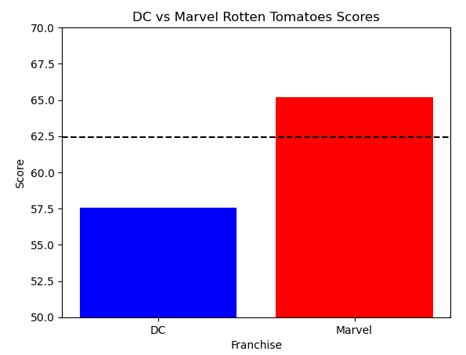

What is the average Rotten Tomato Score for each franchise's films?
62.4%
Notes:
DC returns a mean Rotten Tomato Score of 57.56 and Marvel returns a Rotten Tomato Score of 65.21

Slide 6

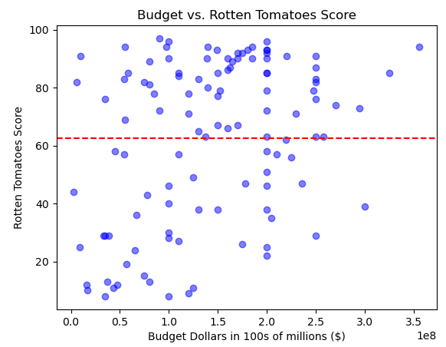

Less than $100M $150M-$190M Greater than $200M
What is the effect of the film budget on the Rotten Tomato Score?
Notes:
$150M-$190M nets a higher Rotten Tomato Score than budgets over $200M. Once budgets are greater than $250M the Rotten Tomato Score increases. Under $100M scores are lower.

Slide 7

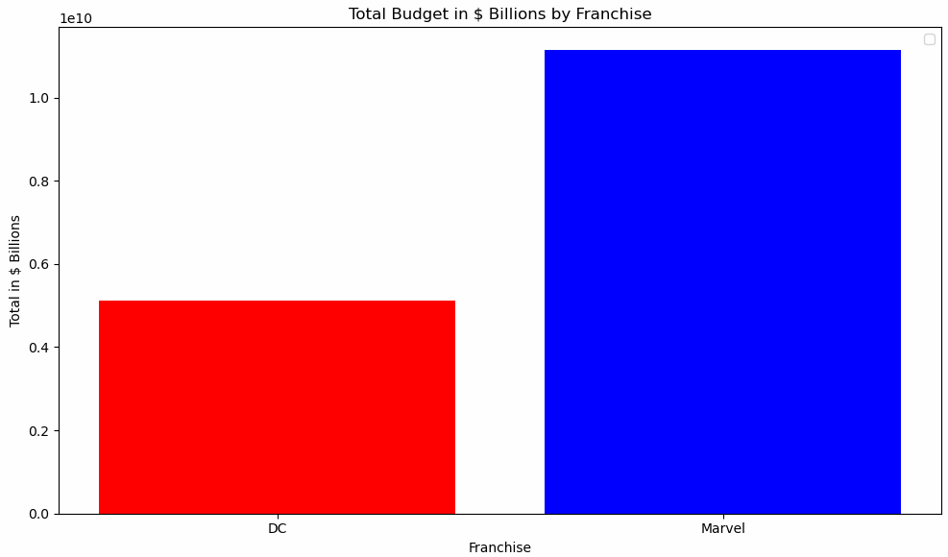
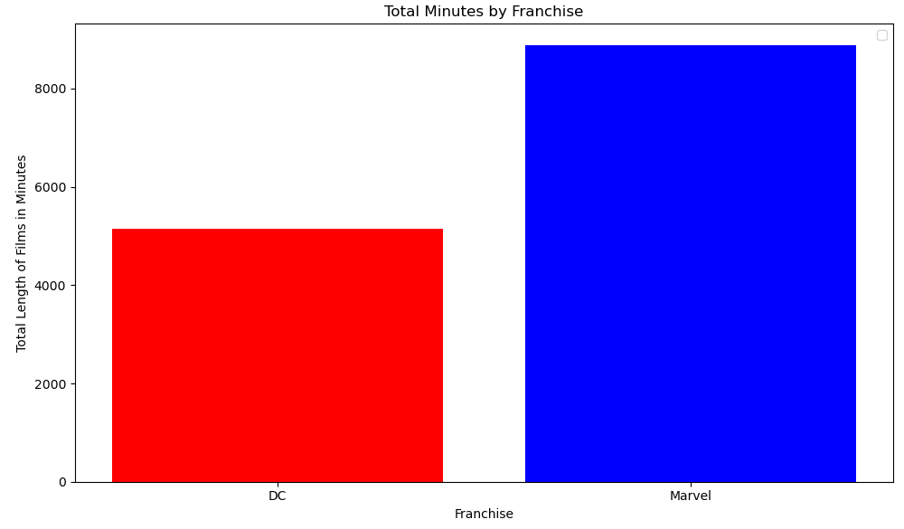

DC spends $990k. Marvel spends $1.3M.
Does the budget set for the film affect the length of the film, in minutes?
Notes:
DC spends approximately $990k per minute to produce a film. Marvel spends approximately $1.3M per minute to produce a film.

Slide 8


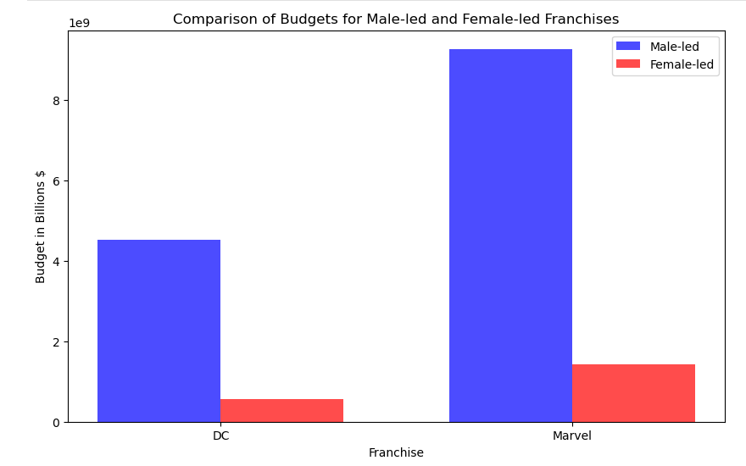
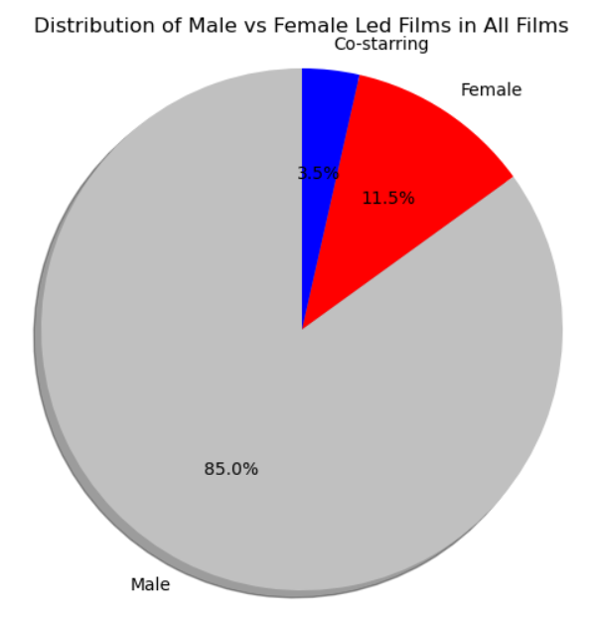
Does the main character lead (Male or Female) affect the budget?
3.5%
11.5%
85%
Notes:
Both Marvel and DC set budgets within 15% of the average budget for films. There was not a significant difference in male/female led film budgets.

Slide 9


Which is Super-ior?
Marvel is Super-ior over DC
Marvel may spend more money per minute to produce a film, however they net a higher profitability compared to their budget and have higher rotten tomato scores than the DC film universe does.

